Slide 1


Hotel demand cancellation
Presented by: Maha Abdalla
Presented to: Dr Muhammad Shabir

Slide 2

Introduction:
The hotel industry is a part of the larger travel and tourism sector
The global hotel industry was thriving and worth over $570 billion. The industry has been growing for the past nine years .

Slide 3
Objective:
Have
Have a deeper insight into data
Discover
Discover the best model for prediction cancellation
Find
Find the most significate factors affect cancellation
Offer
Offer business recommandition

Slide 4


Problem:
What we can find when analyzing data
To know if the customers would cancel his booking and the driven factors
What is the recommendation to reduce booking cancellation

Slide 5

Importance of the problems:
Allocating workers to handle the front desk, restaurant, and cleaning
estimating the demand for in-hotel subsidiary businesses like gift shops, gyms, and spas.

Slide 6

Visualizations

Slide 7
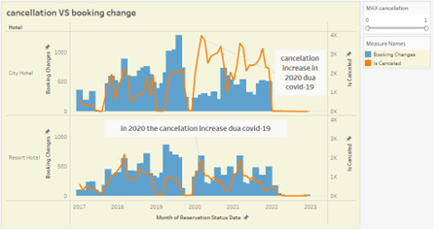
What is the effect of booking changes on Cancellations? Through this correlation we found the relationship between the cancelation and booking change negative.

Slide 8
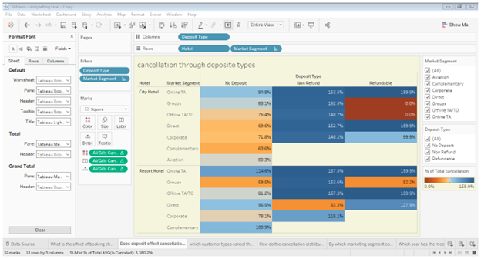
Does deposit effect cancellation? The percentage of cancellations is higher for city hotels

Slide 9
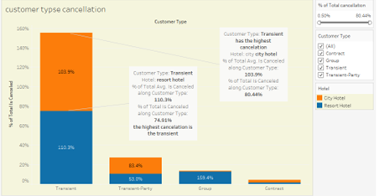
which guests' types cancel the most? Transient cancel the most contract cancel the least

Slide 10
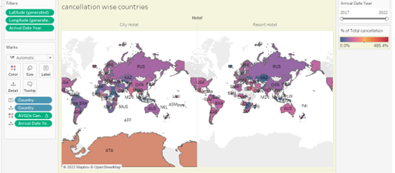
How do the cancellation distribute across various countries? For resort hotel the highest cancellation is from EGY , SAU city hotel the highest cancellation is THA.

Slide 11
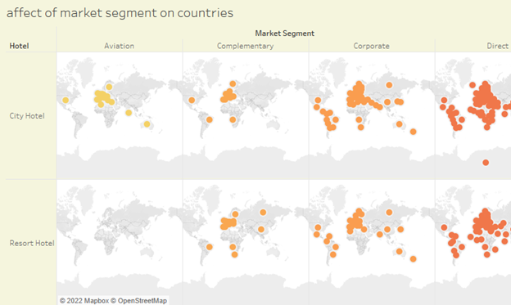
By which marketing segment countries get effected? to see what kind marketing segment can attract people from specific countries. For examples aviation attract guests from NLD, DUA and AUS.

Slide 12
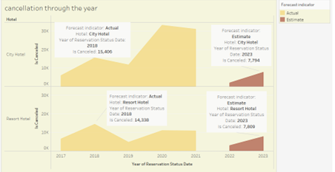
Which year has the most cancellation? The cancellation for resort hotel from 2017 to 2022 is less than city hotel. for both hotels in 2023 the hotel will have less cancellation than previous year

Slide 13
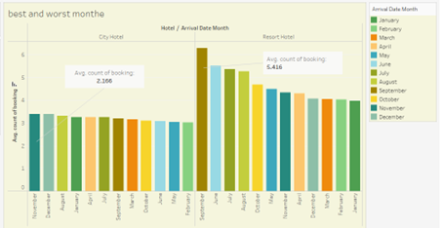
Which Month has Highest and least count of booking By Hotel Type? Resort hotel has the best month from September to august .City hotel best months from November to January .

Slide 14
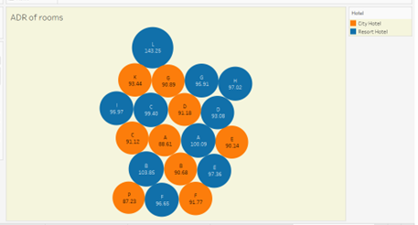
which room type generates highest Average daily rate? Resort hotel have 10 different types room. L room generate AVG ADR by 143.25.City hotel have 9 different room, K room generate AVG ADR by 93.44.

Slide 15
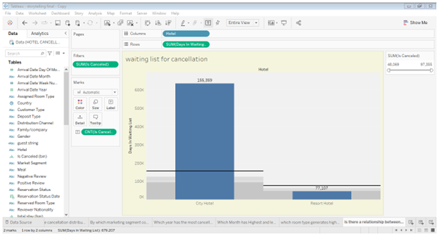
Is there a relationship between waiting list and cancellation? Through this correlation we found the relationship between the cancelation and waiting time positive.

Slide 16
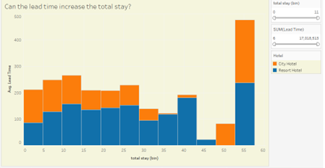
Can the lead time increase the total stay? Through this correlation we found the relationship between the lead time and total stay positive.

Slide 17
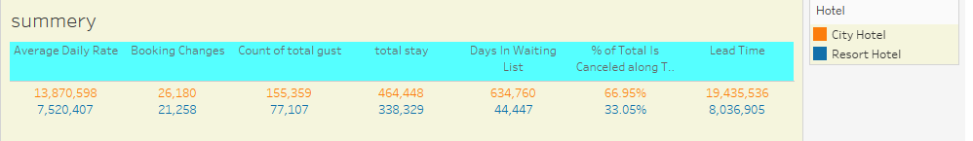
This graph show simple statics for city and resort hotel
The sum for both hotels in ADR and booking change, days in waiting list and lead time
The number of total guests
The perecentage of cancelation for both hotels

Slide 18

Recommendation:
Total number of booking change reduce the chances of cancellation.
Made the no refundable policy on all of booking types in hotels.
Increase the number of rooms to reduce time in waiting list.
Make loyal program for repeated guests
Offer discount for guests that pay at time of booking.
do not allow one-night bookings on busy days, or when an event is happening nearby.
Make more marketing campaign

Slide 19

Conclusion:
Majority of the room booked are city hotel
high rate of cancellations can be due high no deposit policies.
We should also target months between sep to Aug for resort. jan to feb city
Majority of the guests are from afriaca and south asia
Given that we do not have repeated guests
Lead time, deposited time, special request, parking and room types are importance features
Focuse on reducing the time in waiting list.

Slide 20

Any questions

Slide 21

Thank you

